Slide 1
EEP 547 – Linear System Theory MinSeg Project
Presented by:
Matthew Russo
Jayce Gaddis

Slide 2

Models
The mathematical model of the MinSeg robot configured as an inverted pendulum was derived from the given EOM
The position, velocity, angle, and angular velocity of the MinSeg were chosen as the state variables as they can be derived from the equipped gyro, accelerometer, and encoder.
The output of the system is the voltage to the motor

Slide 3
Measurements of the Model Parameters
Many of the model parameters were simple to measure including length to COM, mass, and wheel radius.
The more difficult parameters were the moments of inertia for the wheel and pendulum.
A ramp was used to measure the time it took for the wheel to accelerate down the ramp. The wheel moment was calculated from the radius, wheel mass, and acceleration.
To measure the MOI for the pendulum, the period of the pendulum pivoting on its axel was measured by counting the number of oscillations over a length of time.
This method was flawed, because of human interference from holding the robot by its axel.
Instead of using this method, the MOI was estimated as if all the mass of the robot was centered at the COM.

Slide 4
Analysis of Stability
0 | 1 | 0 | 0
82.5 | -61.8 | 0 | -2945.1
0 | 0 | 0 | 1
6.7 | -10.9 | 0 | -516.9
A =
Eigenvalues: 0, -578.8, 6.3332, -6.2592
Roots: 0, -578.8, 6.3332, -6.2592
No stability
Asymptotically stable? – positive eigenvalue
BIBO stable? – positive root

Slide 5
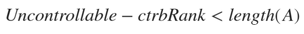
Controllability
It was determined that the rank of the controllability matrix was equal to the size of A (Length(A) = 4 ctrbRank = 4 ).
Therefore, the system is controllable – able to reach any new state from any previous state with controlled input

Slide 6

Observability
It was determined that the rank of the observability matrix was equal to the size of A (Length(A) = 4 obsvRank = 4 ).
Therefore the system is observable – all states can be known from the output

Slide 7
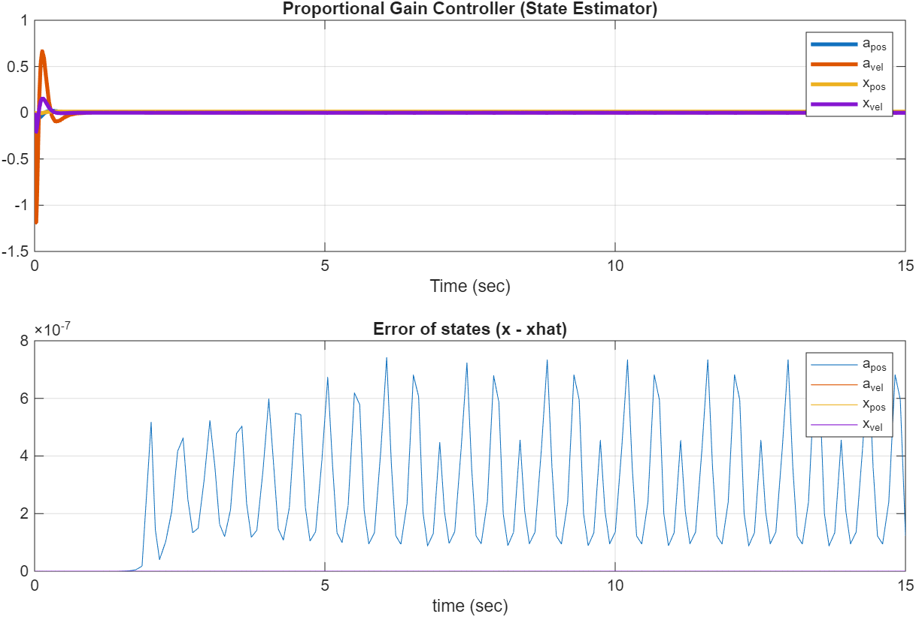
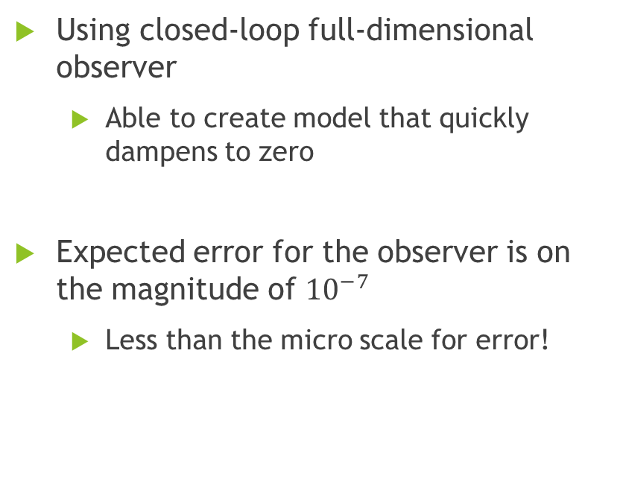
Controller and Estimator
Using closed-loop full-dimensional observer
Able to create model that quickly dampens to zero
Expected error for the observer is on the magnitude of ${10}^{−7}$
Less than the micro scale for error!

Slide 8
Analysis of Stability – New poles
desiredPropGainPoles = [-24, -18, -16, -12];
A_cl = A-BK =
Closed-loop eigenvalues = [-24, -18, -16, -12];
System Stable~!
0 | 1 | 0 | 0
-13425 | -2167 | 8830 | 6259
0 | 0 | 0 | 1
-2364 | -380 | 1550 | 1099

Slide 9
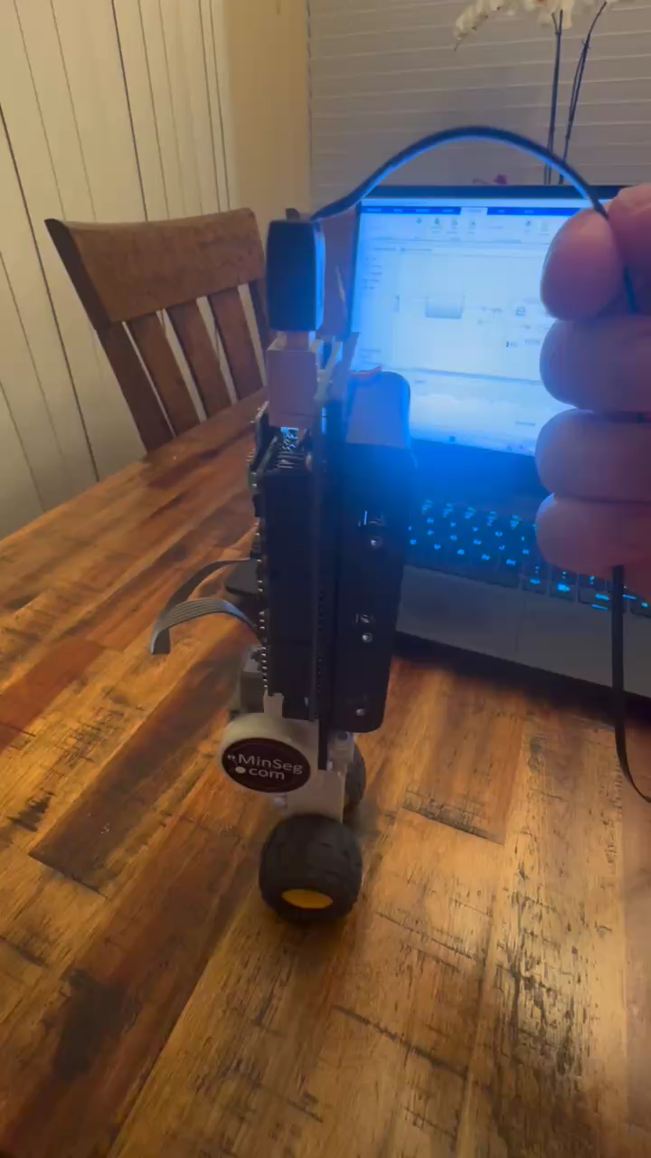
Video proof – PID Controller

Slide 10
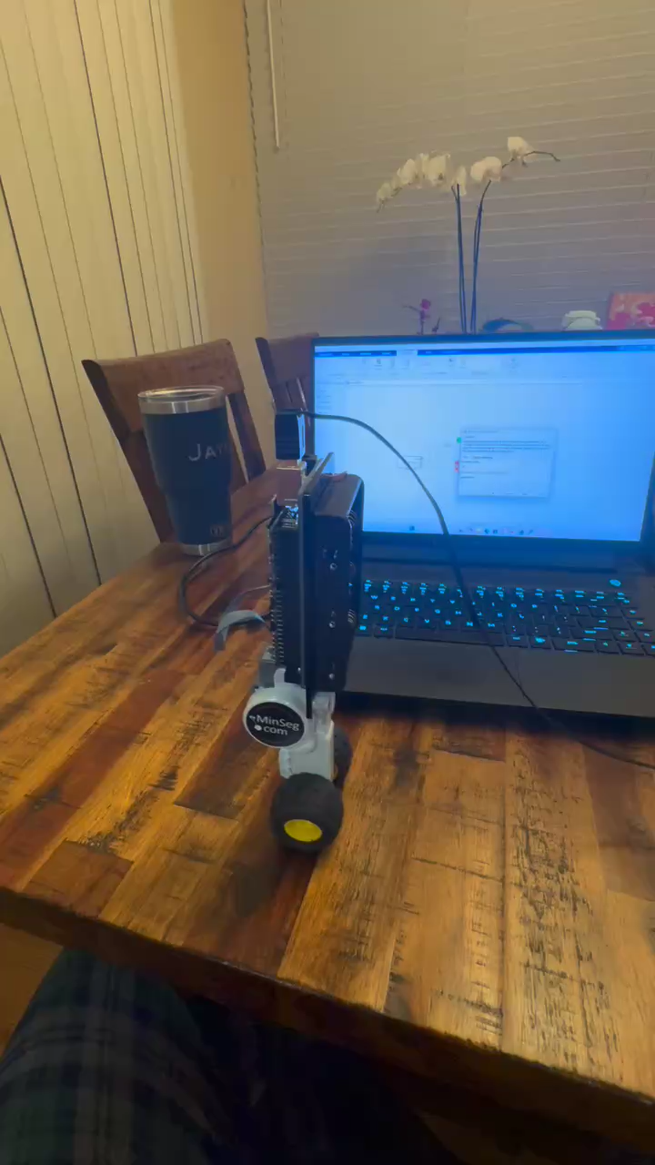
Video proof – LQR Controller

Slide 11
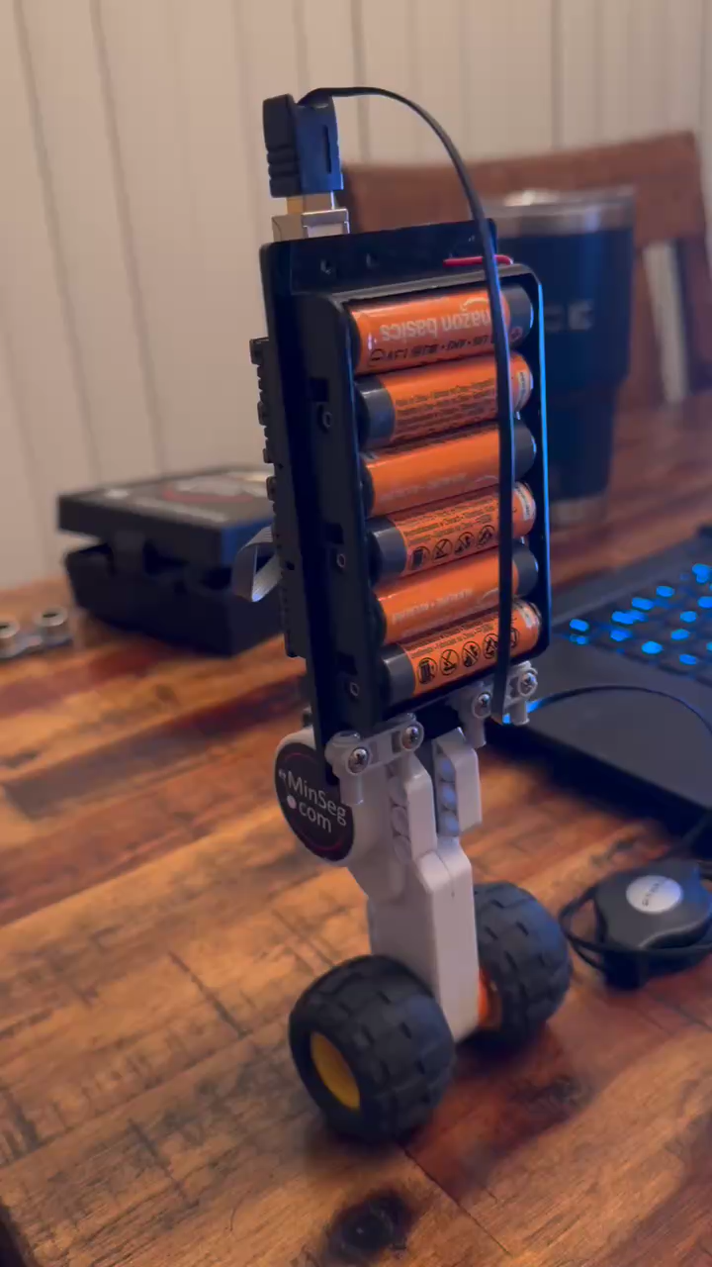
Video Proof – LQR Control with Batteries

Slide 12
Sensor
An ultrasonic sensor was added to the LQR feedback model to add a small amount to the X feedback when an object is near.
The effect of this is that the robot stabilizes itself moving slightly away when an object is detected, but when the object is removed, the robot loses stability. This forms a leash mechanism which stops the Minseg if an operator moves away.

Slide 13
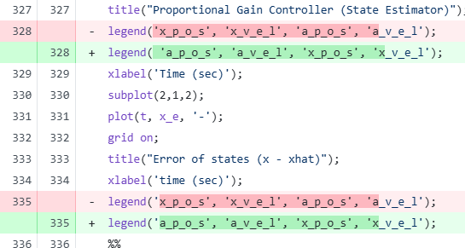
Challenges

Slide 14

Thank you

